Slide 1
What is a Predictive Model?
Matthew Engelhard
Notes:
Preliminaries – Intro
Plan for the weekend (lecture structure, computational assignment)
We’ll cover the quiz during the discussion section
Any questions about the course to start?

Slide 2
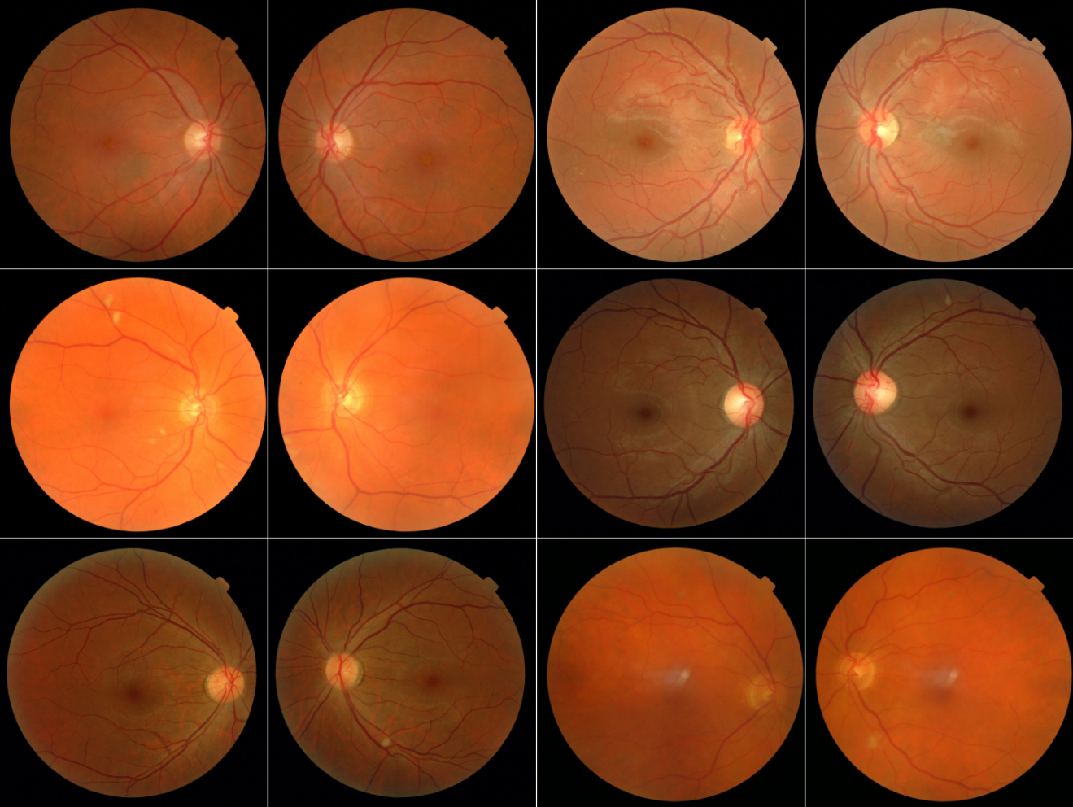
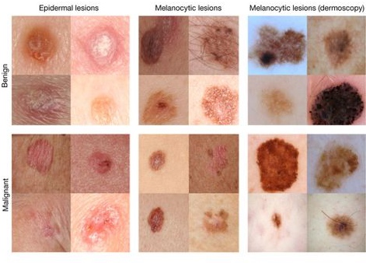
Medical Image Analysis with ConvNets
Improved Automated Detection of Diabetic Retinopathy
Invest. Ophthalmol. Vis. Sci.. 2016;57(13):5200-5206. doi:10.1167/iovs.16-19964
Dermatologist-level classification of skin cancer
Nature volume 542, pages 115–118 (02 February 2017)
Notes:
How does all this affect medicine?
There are five parts to this course. We’ll be talking about the basics of neural networks; CNNs; natural language processing; time-series modeling; and reinforcement learning.
Imaging is already there – we’re getting ML-based diagnostics – plain images, dermoscopy, ultrasound, fundoscopic images, radiology, pathology, etc.
NLP is right on the cusp – so far the ‘NLP’ that’s out there hasn’t been very smart – very context aware – but NLP systems are right at human-performance, and it’s going to start making a huge impact very soon. Can only hope that NLP starts reducing some of the documentation burden placed on physicians.
RL is also very close, though evaluation here is more difficult.

Slide 3
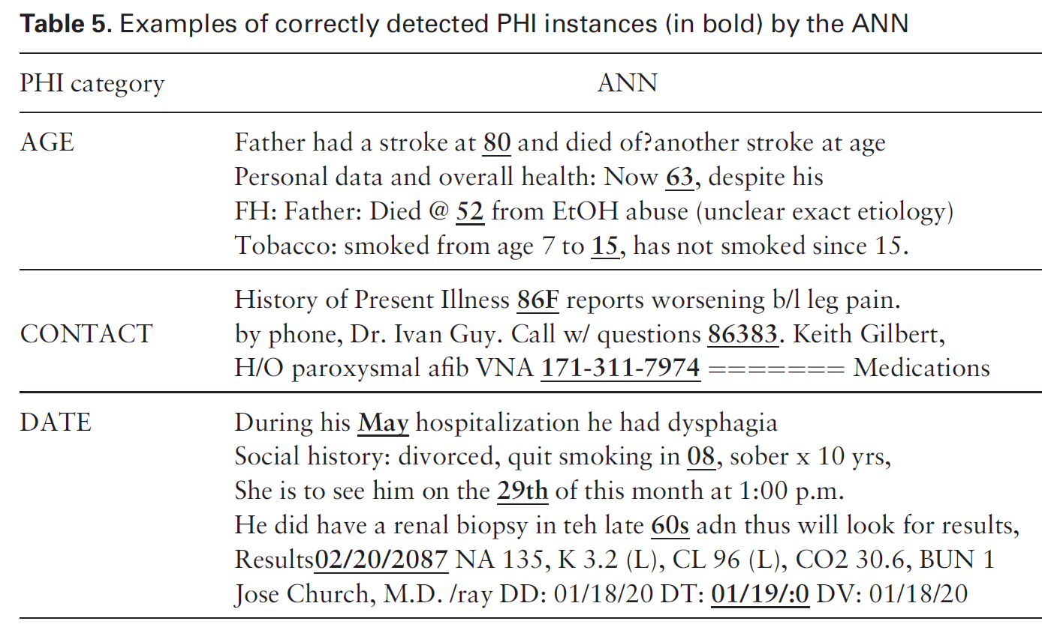
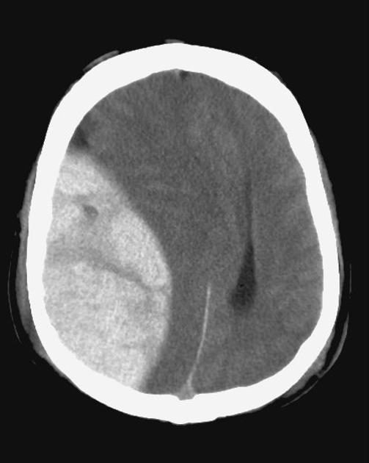
Biomedical Text Processing
Classification of radiology reports using neural attention models, IJCNN 2017
De-identification of patient notes with recurrent neural networks
JAMIA 24(3), 2017, 596–606
Mass effect from extradural hemorrhage
https://radiopaedia.org
Notes:
How does all this affect medicine?
There are five parts to this course. We’ll be talking about the basics of neural networks; CNNs; natural language processing; time-series modeling; and reinforcement learning.
Imaging is already there – we’re getting ML-based diagnostics – plain images, dermoscopy, ultrasound, fundoscopic images, radiology, pathology, etc.
NLP is right on the cusp – so far the ‘NLP’ that’s out there hasn’t been very smart – very context aware – but NLP systems are right at human-performance, and it’s going to start making a huge impact very soon. Can only hope that NLP starts reducing some of the documentation burden placed on physicians.
RL is also very close, though evaluation here is more difficult.

Slide 4
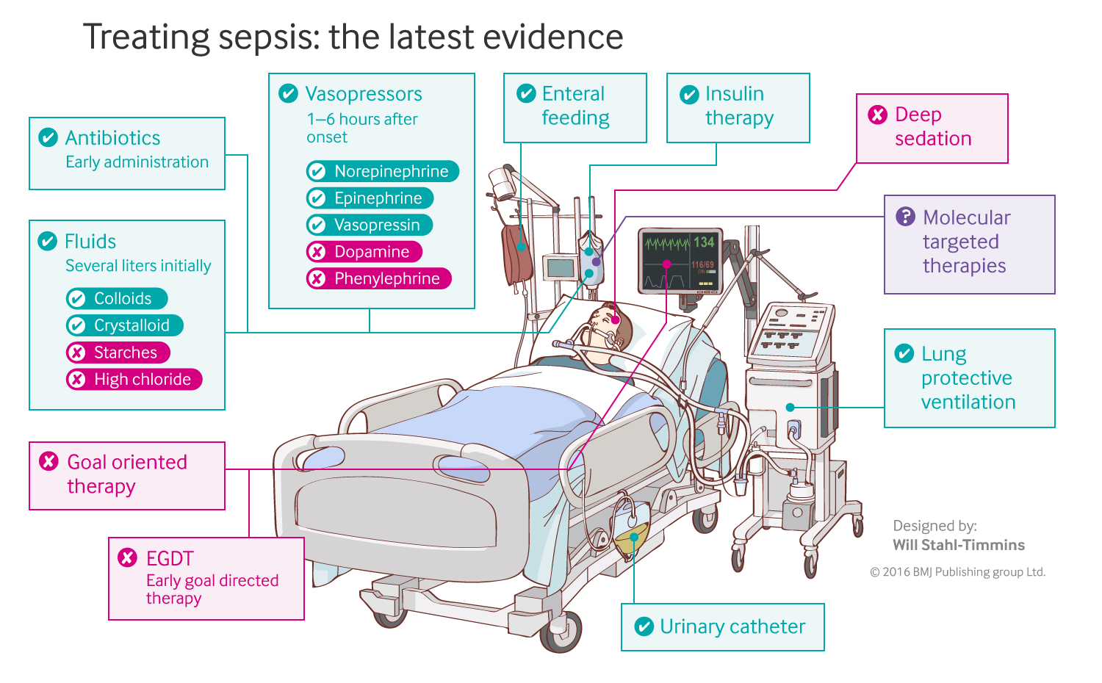
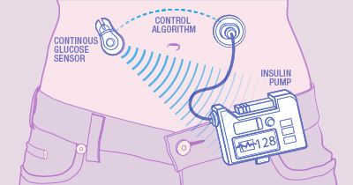
Sequential Prediction and Decision-Making Algorithms
Closed-loop blood glucose control
(“artificial pancreas”)
Fluid and vasopressor administration
for sepsis treatment
https://www.mayo.edu/research/labs/artificial-pancreas/overview
Gotts JE, Matthay MA. Sepsis: pathophysiology and clinical management. bmj. 2016 May 23;353(i1585).
Notes:
How does all this affect medicine?
There are five parts to this course. We’ll be talking about the basics of neural networks; CNNs; natural language processing; time-series modeling; and reinforcement learning.
Imaging is already there – we’re getting ML-based diagnostics – plain images, dermoscopy, ultrasound, fundoscopic images, radiology, pathology, etc.
NLP is right on the cusp – so far the ‘NLP’ that’s out there hasn’t been very smart – very context aware – but NLP systems are right at human-performance, and it’s going to start making a huge impact very soon. Can only hope that NLP starts reducing some of the documentation burden placed on physicians.
RL is also very close, though evaluation here is more difficult.

Slide 5
In each of these cases, we have a machine that receives data and makes a related prediction: a “predictive model”

Slide 6
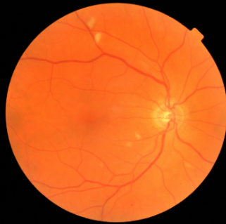
image -> prediction: computer vision
y, referrable diabetic retinopathy
x, retinal image
End goal: predict y from x
Notes:
I said before that those examples above, they all have a predictive model at their core
Let’s look at each in turn
In computer vision, the simplest case is that we have an image – that’s the x – and we want to make a prediction
Ones that have been studied:
Identify referable diabetic retinopathy
Identify abnormal proliferation of blood vessels
Identify Alzheimer’s disease?
At this point, a couple of important asides.
First, NONE of this is causal. The fact that a retinal image can be used to predict the presence / absence of Alzheimers does not mean that something about the retina is causing Alzheimers. Obvious in this case, but important to remember that in general, prediction doesn’t imply anything about causation.
Second, prediction isn’t saying anything about the future. We’re just making a guess about some value associated with the image.
Third, there’s clinical intuition and knowledge that comes into play at many steps along the way to developing a model like this. But the first one – have to decide whether the task is even reasonable… is it reasonable to think that…

Slide 7
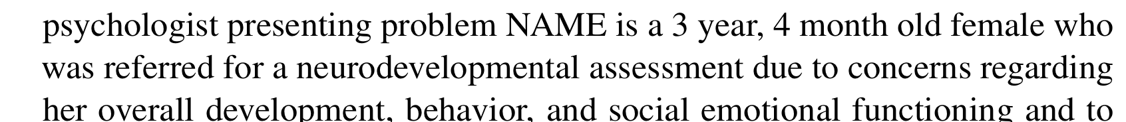
text -> prediction: natural language processing
y, autism risk
x, clinical note
End goal: predict y from x
Notes:
Let’s move on to NLP – again, we have an x – a clinical note
We’ll talk about how you can feed text into a predictive model in the third lecture – it is not obvious, or at least it wouldn’t be to me
At this point, what’s important is that again, we have a machine that takes this note and spits out a prediction about it
In my research, as I mentioned, the prediction is whether it’s associated with later development of autism

Slide 8
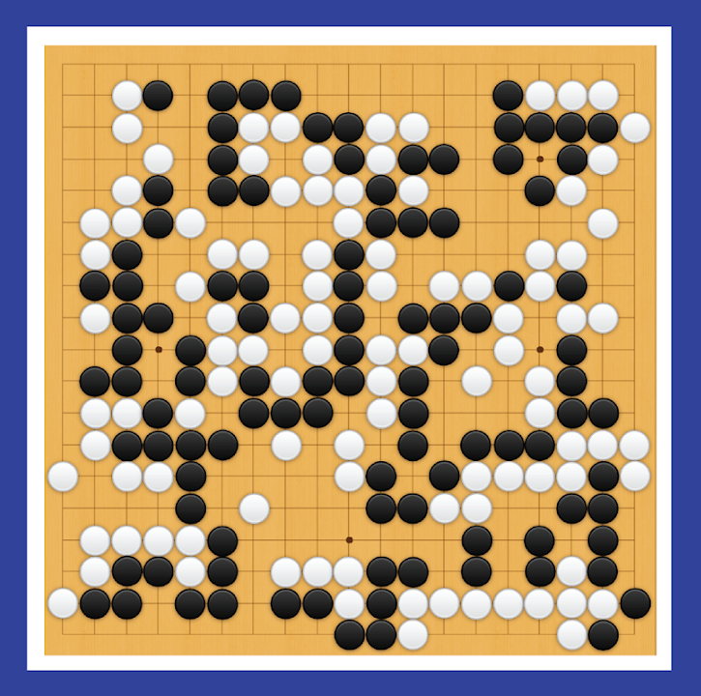
“state of the world” -> next action: reinforcement learning
y, next move
x, Go board state
End goal: predict y from x
Notes:
In the RL example, the predictive model is least obvious, but I can give some intuition here…
(explain)
And in the sepsis management setting, the “state of the board” is the patient’s physiologic status.

Slide 9

features $x$ -> prediction $y$: a predictive model
y, associated value or label
x, data/features for a subject or patient
End goal: predict y from x
Notes:
Suppose we have a vector of measurements (x)
Associated with those measurements is an outcome – or a label – or another measurement (y)
We’d like to make a prediction about (y) that is based on (x)
Maybe (y) is a home price. X is a bunch of information about that home, e.g. square footage, number of bedrooms, how old, neighborhood, school district. Let’s say we’d like to make an informed guess about the home price based on all that information. What we need is a predictive model.
Might call them covariates, might call them predictors. In this class, we will most often call them ‘features’

Slide 10
Simple models often work well for clinical data!
WBC Count
Respiratory Rate
Creatinine
Mean BP
Hematocrit
Pulse Rate
Temperature
Survival
Age
y, associated value or label
x, data/features for a subject or patient
End goal: predict odds of hospital mortality
(APACHE III)
Notes:
In medicine, often x is a fairly simple set of features
In an ICU setting, we might want a model that takes a bunch of measurements about a patient -- their age (demographics), vitals, lab values, and some information about chronic health conditions and predicts their risk of dying (or likelihood of surviving…)
In fact, there is a well known model used for this purpose: ACUTE PHYSIOLOGY AND CHRONIC HEALTH EVALUATION – it’s been around since the 70s (we’re now on APACHE III
Models that deal effectively with highly complex data, like images – those are fairly new
But predictive models are NOT new, AT ALL, in medicine
Think cardiology, Framingham, pooled cohort equations, etc
When you have data like these, you don’t need a super complex model – you typically don’t need a neural network
Don’t want to make these things more complicated then necessary – we should use the simplest and most interpretable model that will do the job

Slide 11
Before we tackle complex models, let’s carefully examine a very simple one.
x, a single measurement:
prostate specific antigen
y, associated label:
prostate cancer
(0 = absent, 1 = present)
End goal: predict y from x
Notes:
But let’s save the more complex models for lectures 2 and 3. Our goal today is to build some intuition around (a) what thet predictive model is, and (b) how it can be used
And to do that, we’re going to focus on a very simple example – just about the simplest predictive model you might realistically use (and that is in fact used in medicine)
We want to make a prediction based on a single measurement.
The one I’d like to consider is this:
Make a prediction about whether someone has prostate cancer based on a single prostate specific antigen measurement
Now, let me remind you again – I am NOT an expert in the diagnosis of prostate cancer – I do know enough to be quite sure that the method I’m going to discuss is very far from what’s actually done, and that there are many more biomarkers that are used in prostate cancer surveillance
This is for the purposes of illustration

Slide 12
Prostate specific antigen measurement in individuals with vs without prostate cancer
Notes:
Let’s suppose we collected PSA values in a large number of patients
Then, we determined, through some gold standard – biopsy, let’s say – whether they have prostate cancer
Our goal is to find a best rule for predicting whether cancer is present based on the PSA alone.
If our rule works well enough, maybe it will spare us from doing so many biopsies in the future.
So, we’ve collected all these values, and we can group them by the gold standard result
On the top, we have all the PSA values for individuals who did not have prostate cancer, and on the bottom, we have all the values for those who did
So, on the one hand, whether someone has cancer tells us something about what the PSA value is likely to be.
But by the same token, the PSA value can tell us something about whether someone might have prostate cancer
Again, to be clear, this is not causal – nobody thinks that PSA is causing prostate cancer
But we can use the PSA value to infer something about cancer likelihood

Slide 13
End Goal: predict cancer status (y) based on PSA (x)
Notes:
Let’s build a predictive model – a very simple “machine”, i.e. algorithm, that will allow us to make a prediction about cancer status from the PSA

Slide 14
End Goal: predict cancer status (y) based on PSA (x)
below threshold: predict negative
above threshold: predict cancer positive
Notes:
We’re doing to do it with a simple threshold – we pick a value of the PSA
Above it, we’re going to predict that the patient has prostate cancer
Below it, we’ll predict they don’t
And so our job is to explore what happens when we pick a specific threshold
We’d like to pick a good threshold, one that distinguishes between positive and negative cases effectively
We can immediately see some bad thresholds – 0 and 15

Slide 15
End Goal: predict cancer status (y) based on PSA (x)
below threshold: predict negative
above threshold: predict cancer positive
TRUE POSITIVES

Slide 16
End Goal: predict cancer status (y) based on PSA (x)
below threshold: predict negative
above threshold: predict cancer positive
FALSE NEGATIVES
TRUE POSITIVES

Slide 17
End Goal: predict cancer status (y) based on PSA (x)
below threshold: predict negative
above threshold: predict cancer positive
Sensitivity:
% of positives correctly identified
True Positives / Positives
TP / (TP + FN)
FALSE NEGATIVES
TRUE POSITIVES
Notes:
The proportion of positives that we correctly predict are positives – that’s the sensitivity
We’ll come back to this and more performance metrics later

Slide 18
End Goal: predict cancer status (y) based on PSA (x)
below threshold: predict negative
above threshold: predict cancer positive
TRUE NEGATIVES

Slide 19
End Goal: predict cancer status (y) based on PSA (x)
below threshold: predict negative
above threshold: predict cancer positive
TRUE NEGATIVES
FALSE POSITIVES

Slide 20
End Goal: predict cancer status (y) based on PSA (x)
below threshold: predict negative
above threshold: predict cancer positive
TRUE NEGATIVES
FALSE POSITIVES
Specificity:
% of negatives correctly identified
True Negatives / Negatives
TN / (TN + FP)
Notes:
The proportion of negatives that we correctly predict are negatives – that’s the specificity
Again, we’ll come back to this later

Slide 21
End Goal: predict cancer status (y) based on PSA (x)
below threshold: predict negative
above threshold: predict cancer positive
Increase the threshold:
1. Specificity goes up.
(we’re catching more negative cases)
TRUE NEGATIVES
FALSE POSITIVES

Slide 22
End Goal: predict cancer status (y) based on PSA (x)
below threshold: predict negative
above threshold: predict cancer positive
Increase the threshold:
1. Specificity goes up.
(we’re catching more negative cases)
2.Sensitivity goes down.
(we’re catching fewer positive cases)
TRUE NEGATIVES
FALSE POSITIVES
FALSE NEGATIVES
TRUE POSITIVES
Notes:
Question: what about PPV and NPV?

Slide 23
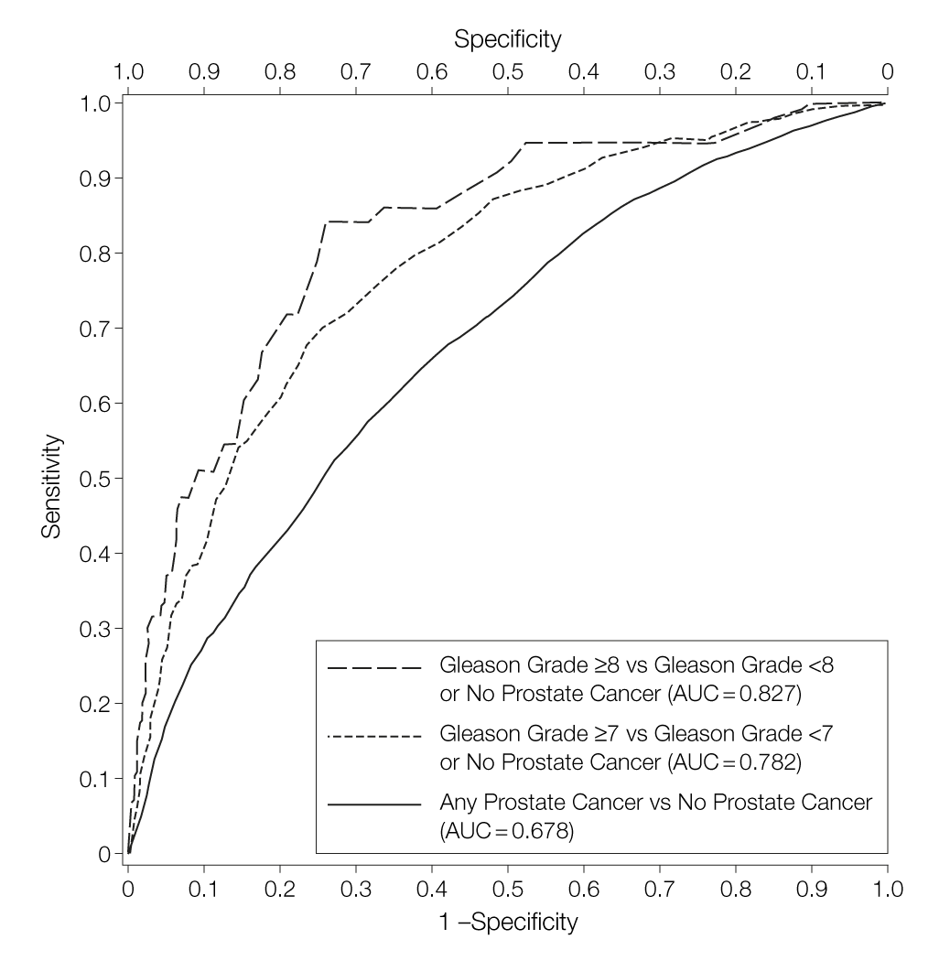
The ROC curve
(i.e. sensitivity/specificity curve)
quantifies performance across all possible thresholds
Thompson IM, Ankerst DP, Chi C, et al. Operating Characteristics of Prostate-Specific Antigen in Men With an Initial PSA Level of 3.0 ng/mL or Lower. JAMA. 2005;294(1):66–70. doi:10.1001/jama.294.1.66
Notes:
We can plot sensitivity / specificity pairs for all possible thresholds
This helps us to understand how good a predictor PSA is under for a range of circumstances
We might be more interested in identifying positive cases
We might be more interested in ruling out cases
Sometimes you’ll hear about the “area under the ROC curve” – this is meant to quantify performance in a way that’s agnostic to the particular threshold
It is often criticized, and not always the appropriate metric, but still a good one

Slide 24
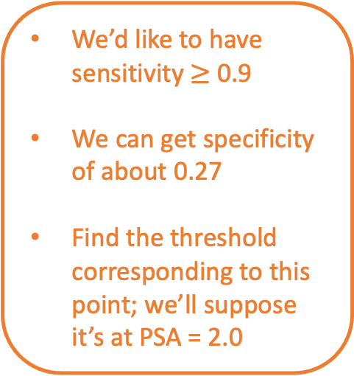
The ROC curve
(i.e. sensitivity/specificity curve)
quantifies performance across all possible thresholds
We’d like to have sensitivity $≥$ 0.9
We can get specificity of about 0.27
Find the threshold corresponding to this point; we’ll suppose it’s at PSA = 2.0
Thompson IM, Ankerst DP, Chi C, et al. Operating Characteristics of Prostate-Specific Antigen in Men With an Initial PSA Level of 3.0 ng/mL or Lower. JAMA. 2005;294(1):66–70. doi:10.1001/jama.294.1.66
Notes:
We can plot sensitivity / specificity pairs for all possible thresholds
This helps us to understand how good a predictor PSA is under for a range of circumstances
We might be more interested in identifying positive cases
We might be more interested in ruling out cases
Sometimes you’ll hear about the “area under the ROC curve” – this is meant to quantify performance in a way that’s agnostic to the particular threshold
It is often criticized, and not always the appropriate metric, but still a good one

Slide 25
Our first, very simple predictive model
End Goal: predict cancer status (y) based on PSA (x)
Our rule:
if PSA > 2.0, predict positive
else predict negative
Notes:
We’re using data – the observed PSA level – to make a prediction about whether the person has prostate cancer
How did we choose a good threshold?
Well, we collected a bunch of data -- a bunch of PSA measurements with corresponding cancer status
We were then able to see, based on historical data – we can call it a training set – what threshold was needed to achieve a sensitivity of 0.9
Having set that threshold, we can now make cancer predictions for new patients whenever we collect a PSA
And if we collect PSA measurements in a bunch of new patients, then assess their cancer status, we can see how well our threshold performs in the new cohort, which we didn’t use to select the threshold
In other words, we can see how well our model generalizes to the new cohort.
If the new cohort is a lot like the old, then we’d expect the threshold would perform about as well
But if the new is systematically different – say, an older cohort – then the threshold might perform very differently

Slide 26
Learning a Predictive Model from Labeled Data
y, associated value or label
x, data/features for a subject or patient
The learning process: find the equation that best predicts y based on x
Notes:
Now let’s go back to our previous model: still simple, but not quite as simple as before
We’d like to learn an equation that best predicts y based on x
So how do we do it?
Well, first we need to decide on the form of the equation – we can think of this as the type of model
In this course, we’ll often choose logistic regression, but that’s for next time
Then we’ll need to tune the equation – find specific parameters, or model coefficients, that predict y best
This is called “learning”, or “training” the model
How do we do it? We need a dataset

Slide 27
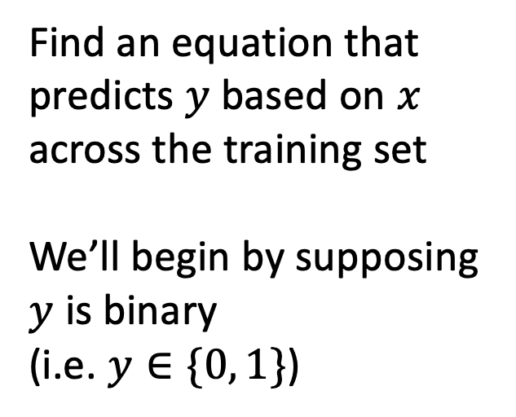
Training Set (Historical Data)
x₁
y₁
Find an equation that predicts $y$ based on $x$ across the training set
We’ll begin by supposing $y$ is binary
(i.e. $y∈\{0, 1\}$)
x₂
y₂
x₃
y₃
x₄
y₄
…
…
x_{N-1}
y_{N-1}
x_{N}
y_{N}
Notes:
Just like in the PSA example, we’re going to collect a bunch of data – pairs of x’s and y’s
And we want to choose the parameters that predict y best based on the x’s, on average, across this dataset
One set of parameters might do a good job predicting y1 based on x1, but not do a good job predicting y3 from x3. We want the parameters that give us the best prediction in this dataset, on average
We’ll formalize this idea later through the idea of a “loss function”

Slide 28
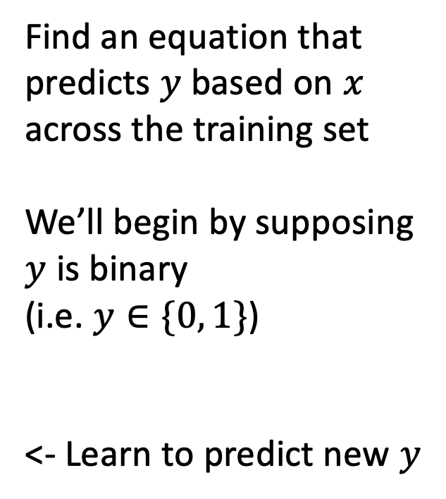

Making Predictions for New $x$
x₁
y₁
x₂
y₂
Find an equation that predicts $y$ based on $x$ across the training set
We’ll begin by supposing $y$ is binary
(i.e. $y∈\{0, 1\}$)
<- Learn to predict new $y$
x₃
y₃
x₄
y₄
…
…
x_{N-1}
y_{N-1}
x_{N}
y_{N}
x_{N+1}
y_{N+1}
Notes:
Once we decide on parameters, then, when we see a NEW value of x, we simply plug it into our “learned” equation, and it tells us what we expect y to be.
This is prediction.
We have a predictive model.

Slide 29
Summary
The data science techniques we will consider in this course, from computer vision to natural language processing, are all examples of predictive models.
The predictive model is the machine in machine learning. It is a specific mathematical equation that is learned from historical data and evaluated by applying it to additional data not used in training.
Predictive models can be very simple or very complex. As a rule of thumb, we want to use the simplest model that performs well.

